Slide 1
HTML basic

Slide 2
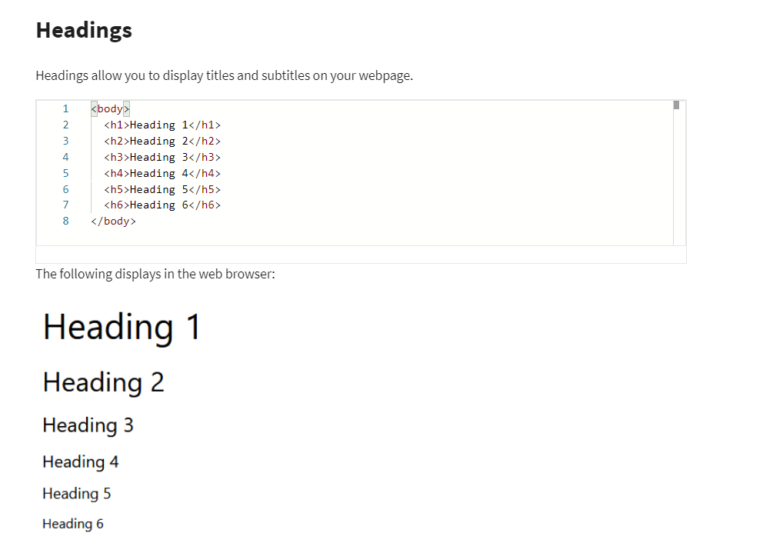
Headings

Slide 3
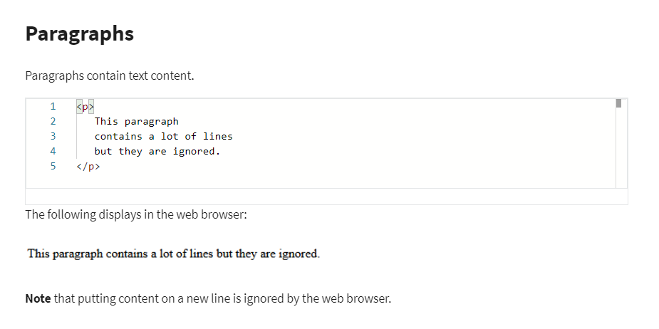
Paragraphs

Slide 4
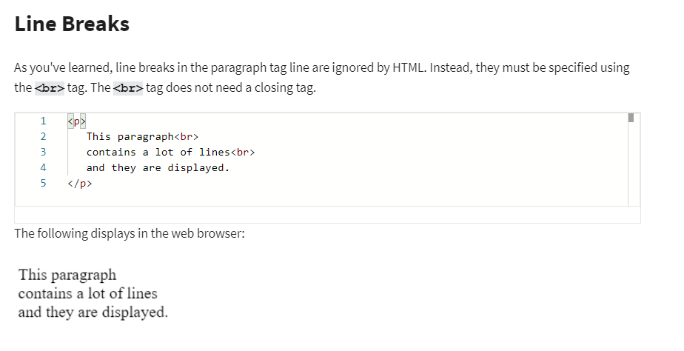
Line breaks

Slide 5
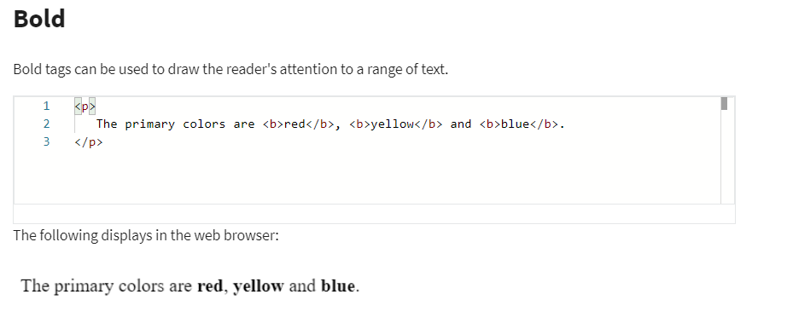
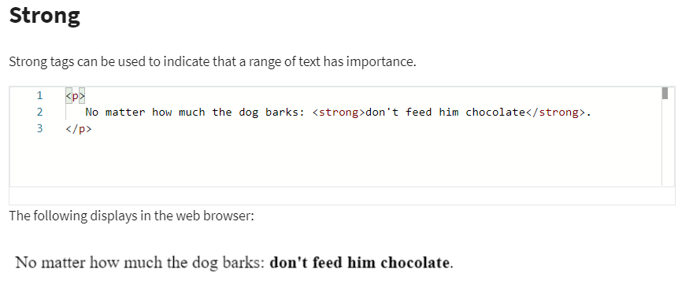
Strong and Bold

Slide 6
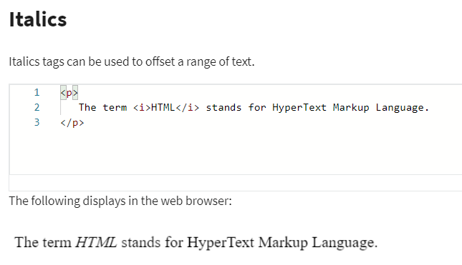
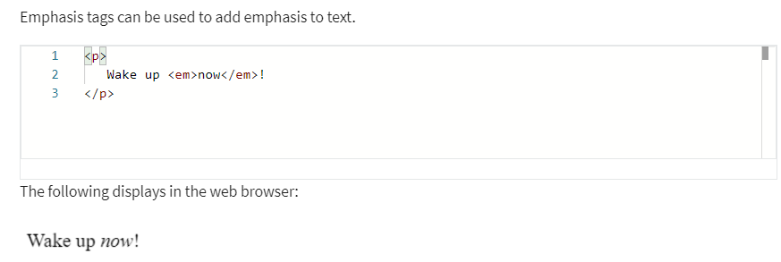
Emphasis and Italics
Emphasis vs. Italics
By default both tags will have the same visual effect in the web browser. The only difference is the meaning.
Emphasis tags stress the text contained in them.
Italics represent off-set text and should be used for technical terms, titles, a thought or a phrase from another language

Slide 7
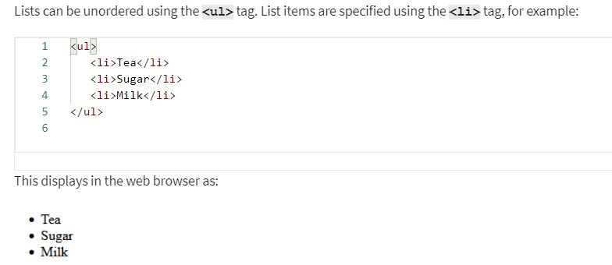
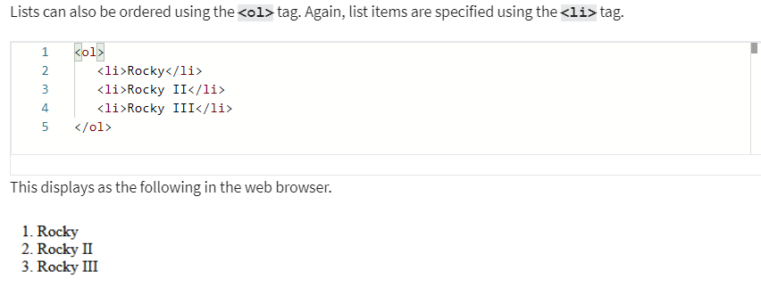
Lists

Slide 8
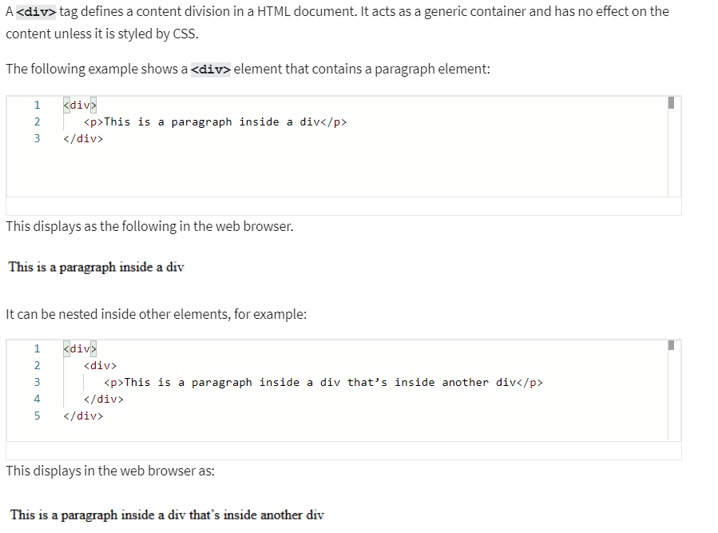
Div tags
the div has no impact on content unless it is styled by CSS.

Slide 9
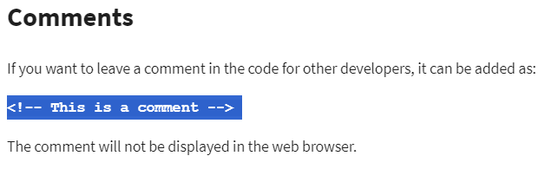
Comments

Slide 10
Anchor
<a href="location.html">Our location</a>
The page you want to jump to
What you want to show in your main page

Slide 11
Image
<img src="1.jpeg" width = "240" height = "135" alt="a text that will not show in the page">
Width, height, alt are optional

Slide 12
Tables
Table element
Table row element
Table header element
<table>
<tr>
<th>Dish</th>
<th>Price</th>
</tr>
<tr>
<td>Hamburger</td>
<td>$10.00</td>
</tr>
<tr>
<td>Salad</td>
<td>$9.99</td>
</tr>
</table>
Table data element

Slide 13
Forms

